Slide 1
Lecture 10
Summary

Slide 2
Regression versus interpolation
Regression
Interpolation
$$x_{1}$$ | $$x_{2}$$ | $$⋯$$ | $$x_{m}$$
$$y_{1}$$ | $$y_{2}$$ | $$⋯$$ | $$y_{m}$$
$$x_{1}$$ | $$x_{2}$$ | $$⋯$$ | $$x_{m}$$
$$y_{1}$$ | $$y_{2}$$ | $$⋯$$ | $$y_{m}$$
$$y=f\left(x;a_{0},a_{1},…,a_{n}\right)$$
$$n+1<m$$
$$y=f\left(x;a_{0},a_{1},…,a_{m−1}\right)$$
$$y_{i}$$
$$y_{i}$$
$$x_{i}$$
$$x_{i}$$
Notes:
We have discussed two approaches to represent a data set by a mathematical model
In regression we had more data points than model parameters that we can freely adjust
Consequently the aim is to choose these model parameters such the model passes reasonably well across them
In the case of interpolation we have the same number of model parameters than data points
They can be chosen such that the model passes exactly by each data point

Slide 3
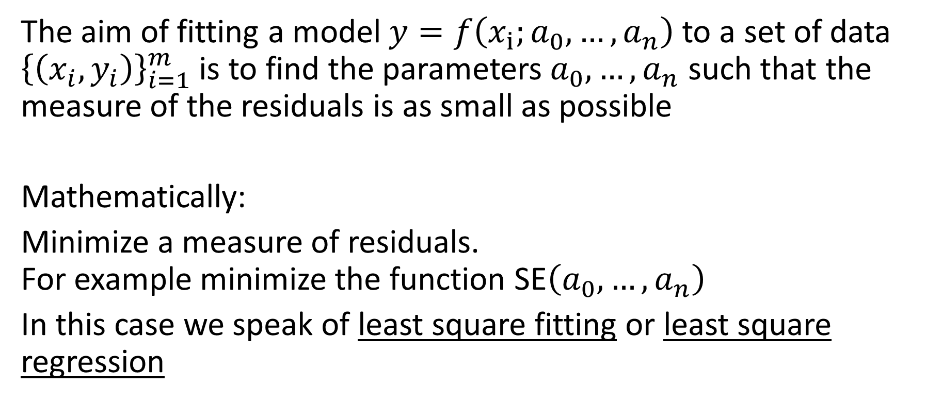
Fitting models to data
The aim of fitting a model $y=f\left(x_{i};a_{0}, …,a_{n}\right)$ to a set of data ${\left\{\left(x_{i},y_{i}\right)\right\}}_{i=1}^{m}$ is to find the parameters $a_{0}, …,a_{n}$ such that the measure of the residuals is as small as possible
Mathematically:
Minimize a measure of residuals. For example minimize the function SE$\left(a_{0}, …,a_{n}\right)$
In this case we speak of least square fitting or least square regression
Notes:
The aim of fitting a model to a set of data is to find the parameters $a_{0}$ to $a_{n}$ such that the measure of the residuals is as small as possible
Mathematically this translates into an optimization problem.
One wants to minimize a measure of residuals, for example minimize the function SE$\left(a_{0}, …,a_{n}\right)$
When the squared error SE is minimized to adjust a model one calls the fitting problem least square fitting or least square regression

Slide 4

Linear regression
For a linear model ${y=a}_{0}+a_{1}x$
$$a_{1}=\frac{m\sum_{i=1}^{m}{x_{i}y_{i}}−\sum_{i=1}^{m}{x_{i}}\sum_{i=1}^{m}{y_{i}}}{m\sum_{i=1}^{m}{x_{i}^{2}}−{\left(\sum_{i=1}^{m}{x_{i}}\right)}^{2}}$$
$$a_{0}=\frac{1}{m}\sum_{i=1}^{m}{y_{i}−a_{1}\frac{1}{m}\sum_{i=1}^{m}{x_{i}}}$$
Notes:
In the case of a linear model we derived a closed form solution for the two parameters ao and a1

Slide 5
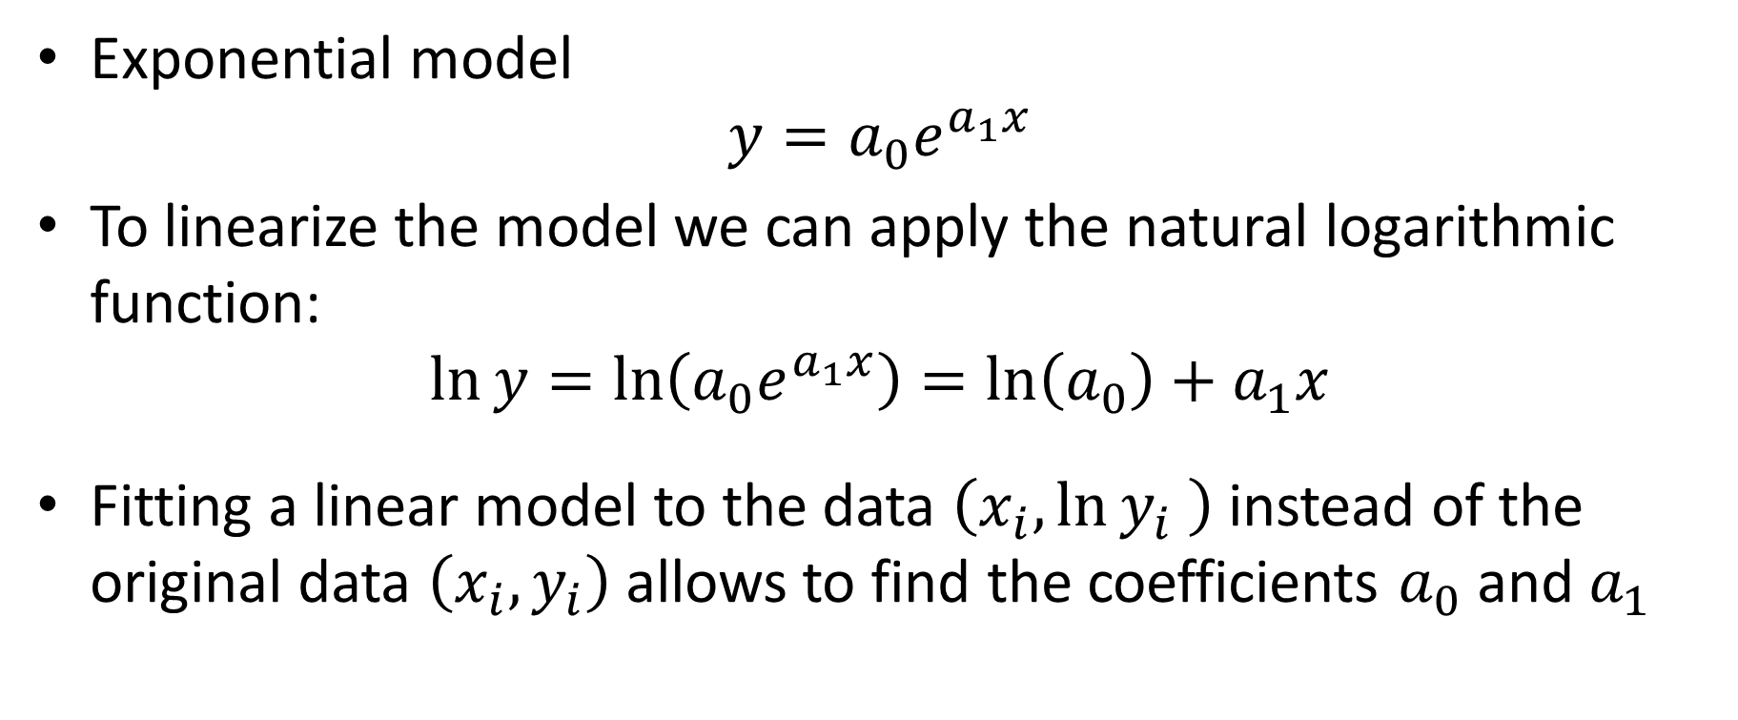
Nonlinear model
Exponential model
$$y=a_{0}e^{a_{1}x}$$
To linearize the model we can apply the natural logarithmic function:
$$\ln{y}=\ln\left(a_{0}e^{a_{1}x}\right)=\ln\left(a_{0}\right)+a_{1}x$$
Fitting a linear model to the data $\left(x_{i},\ln{y_{i}} \right)$ instead of the original data $\left(x_{i},y_{i}\right)$ allows to find the coefficients $a_{0}$ and $a_{1}$
Notes:
Besides linear models we discussed as well two examples of nonlinear models that can, after some changes to the data set, be treated in the same wat as the linear model
The first nonlinear model we discussed was the exponential model
We learned that in semi-log plot, the model becomes linear

Slide 6
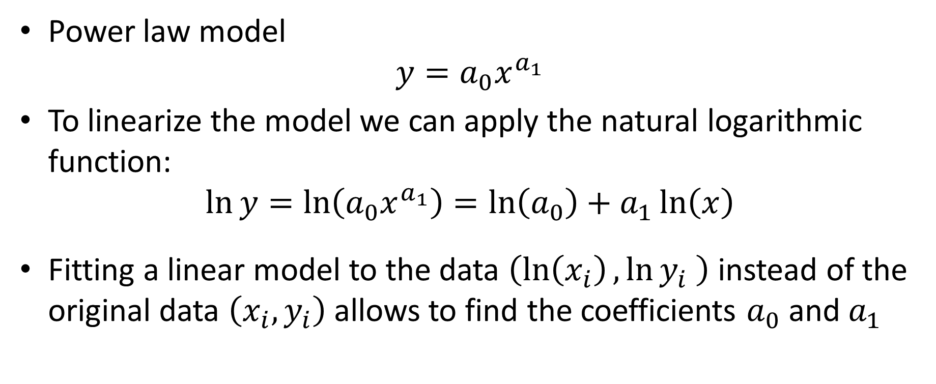
Nonlinear model
Power law model
$$y=a_{0}x^{a_{1}}$$
To linearize the model we can apply the natural logarithmic function:
$$\ln{y}=\ln\left(a_{0}x^{a_{1}}\right)=\ln\left(a_{0}\right)+a_{1}\ln\left(x\right)$$
Fitting a linear model to the data $\left(\ln\left(x_{i}\right),\ln{y_{i}} \right)$ instead of the original data $\left(x_{i},y_{i}\right)$ allows to find the coefficients $a_{0}$ and $a_{1}$
Notes:
The second example of nonlinear model we discussed was the power law
We learned that the model can be linearized using a log-log plot of the data

Slide 7
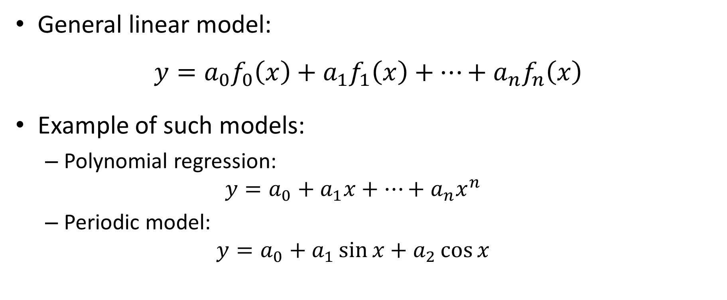
General linear regression
General linear model:
$${y=a}_{0}f_{0}\left(x\right)+a_{1}f_{1}\left(x\right)+…+a_{n}f_{n}\left(x\right)$$
Example of such models:
Polynomial regression:
$${y=a}_{0}+a_{1}x+…+a_{n}x^{n}$$
Periodic model:
$${y=a}_{0}+a_{1}\sin{x}+a_{2}\cos{x}$$
Notes:
A further generalization of the linear model was the introduction of a general linear model in which we can handle modles written as linear combinations of some functions
Examples are polynomial and periodic models

Slide 8

Least square fitting with normal equations
To fit a model by least square:
Write the set of inconsistent equations $A\underline{a}=\underline{b}$ resulting from applying the model to all data points
Solve the normal equations $A^{T}A\underline{a}=A^{T}\underline{b}$ to find the parameters $\underline{\hat{a}}$ of the model which minimize the squared error
Notes:
To adjust the model parameters of a general linear model, we developed the methodology of the normal equations
The methodology has two steps:
First we write the set of inconsistent equations $A\underline{a}=\underline{b}$ resulting from applying the model to all data points
And second we solve the normal equations $A^{T}A\underline{a}=A^{T}\underline{b}$ to find the parameters $\underline{\hat{a}}$ of the model which minimize the squared error

Slide 9
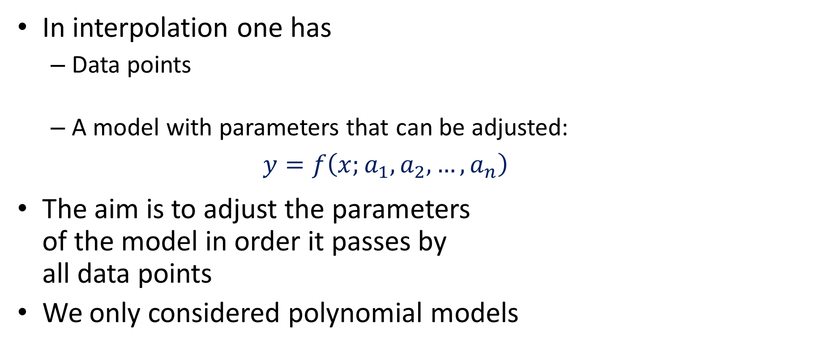


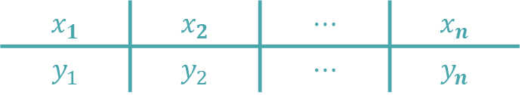
Overview of Interpolation
In interpolation one has
Data points
A model with parameters that can be adjusted: $y=f\left(x;a_{1},a_{2},…,a_{n}\right)$
The aim is to adjust the parameters of the model in order it passes by all data points
We only considered polynomial models
$$x_{1}$$ | $$x_{2}$$ | $$⋯$$ | $$x_{n}$$
$$y_{1}$$ | $$y_{2}$$ | $$⋯$$ | $$y_{n}$$
$$y_{i}$$
$$x_{i}$$
Notes:
In this second part of the lesson we discussed interpolation
As in regression we have a data set and a model with parameters to be adjusted
The difference, compared to regression, is that we have the same numbers of model parameters as data points
This means that the model will pass exactly by all data points
We considered only polynomial interpolation
We discussed three approaches:
Van der Mond
Newton
And Lagrange interpolation

Slide 10

Van Der Mond Equations
Interpolating polynomial:
$${y_{i}=a}_{0}+a_{1}x_{i}+a_{2}x_{i}^{2}+…+a_{n−1}x_{i}^{n−1}$$
Equations to find the model parameters:
$$\left[\begin{matrix}y_{1} \\ \begin{aligned}y_{2} \\ ⋮\end{aligned} \\ y_{n}\end{matrix}\right]=\left[\begin{matrix}1 & x_{0} & x_{0}^{2} & ⋯ & x_{0}^{n−1} \\ 1 & x_{1} & x_{1}^{2} & ⋯ & x_{1}^{n−1} \\ ⋮ & ⋮ & ⋮ & & ⋮ \\ 1 & x_{n−1} & x_{n−1}^{2} & ⋯ & x_{n−1}^{n−1}\end{matrix}\right]\left[\begin{matrix}a_{0} \\ \begin{aligned}a_{1} \\ a_{2} \\ ⋮\end{aligned} \\ a_{n−1}\end{matrix}\right]$$
Van Der Mond matrix
Notes:
In Van der Mond interpolation the model parameters are found by solving a system of linear equation in which the coefficient matrix A is built as follows:
The first column is made out of ones
The next one is made out of the x values of the data set
The third column is the square of these x values
The next one would be the x values power three
It goes on until the last column which is the n-1th power of the x values
The right hand side vector is made out of the y values of the data set

Slide 11


Newton Interpolation
The Newton interpolating polynomial is given by
$$P_{n−1}(x)=$$
$$f\left[x_{1}\right]$$
$$+f\left[x_{1},x_{2}\right]\left(x−x_{1}\right)$$
$$+f\left[x_{1},x_{2},x_{3}\right]\left(x−x_{1}\right)\left(x−x_{2}\right)$$
$$+f\left[x_{1},x_{2},x_{3},x_{4}\right]\left(x−x_{1}\right)\left(x−x_{2}\right)\left(x−x_{3}\right)$$
$$+…$$
$$+f\left[x_{1},…,x_{n}\right]\left(x−x_{1}\right)…\left(x−x_{n−1}\right)$$
Notes:
In Newton interpolation, the interpolating polynomial is written in such a way that it’s coefficients can be computed by Newton divided differences
Newton interpolation is particularly well suited for hand calculations as we saw in the examples

Slide 12





Lagrange Interpolation
The Lagrange interpolating polynomial $P_{n−1}(x)$ is a linear combination of Lagrange polynomials
$$P_{n−1}\left(x\right)=L_{1}\left(x\right)y_{1}+L_{2}\left(x\right)y_{2}+…+L_{n}\left(x\right)y_{n}$$
with $L_{i}\left(x\right)$ the so-called Lagrange polynomials:
$$L_{i}\left(x\right)=\left\{\begin{aligned}1, \\ &0, \end{aligned}\right.$$
$$x=x_{i}$$
$$x=x_{j} \text{for} j≠i$$
$$L_{i}\left(x\right)=\prod_{\begin{aligned}j=1 \\ j≠i\end{aligned}}^{n}{\frac{x−x_{j}}{x_{i}−x_{j}}}$$
Notes:
In Lagrange interpolation, the interpolating polynomial as a linear combination of Lagrange polynomials Li(x).
The Lagrange polynomials Li(x) satisfy a very particular condition:
The Lagrange polynomial Li(x) evaluates to one for x=xi, and evaluates to zero for all other interpolating points.
From this condition, the Lagrange polynomial can be written right away
One of the advantages of Lagrange interpolation is that it doesn’t require any calculation to write down the interpolating polynomial

Slide 13

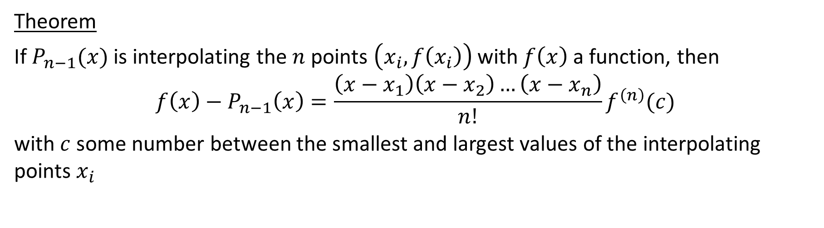
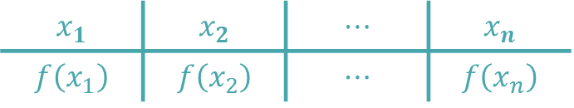
Interpolating function
Interpolation can as well be used to interpolate a function $f(x)$ instead of a data set
$$x_{1}$$ | $$x_{2}$$ | $$⋯$$ | $$x_{n}$$
$$f\left(x_{1}\right)$$ | $$f\left(x_{2}\right)$$ | $$⋯$$ | $$f\left(x_{n}\right)$$
Theorem
If $P_{n−1}(x)$ is interpolating the $n$ points $\left(x_{i},f\left(x_{i}\right)\right)$ with $f\left(x\right)$ a function, then
$$f\left(x\right)−P_{n−1}\left(x\right)=\frac{\left(x−x_{1}\right)\left(x−x_{2}\right)…\left(x−x_{n}\right)}{n!}f^{\left(n\right)}(c)$$
with $c$ some number between the smallest and largest values of the interpolating points $x_{i}$
Notes:
Interpolation can be used as well to approximate functions instead of data sets
In this case we choose n interpolations points x1 to xn.
The corresponding y values are the function values evaluated in these points
There exist a theorem that can be used to estimate the interpolating error for such cases

Slide 14
Interpolation Issues
The interpolating polynomial can wiggle significantly around the data
Notes:
One of the issue one can encounter with interpolation, when too many points are in the data set, is a wiggling polynomial
Such interpolating polynomial, even passing by all data points, does hardly represent the data set

Slide 15
Splines
Notes:
A solution to this problematic is piecewise, or spline interpolation
In this case on no longer interpolates over the complete data set but on subsets
A popular implementation is the cubic spline interpolation in which one does choose the cubic interpolating polynomials such that the border points of the subintervals their derivatives matches. This is done in order to achieve smooths looking curves

Slide 16






Bezier Curves
Control points
$$y$$
$$\left(x_{4} ,y_{4} \right)$$
$$\left(x_{2} ,y_{2} \right)$$
$$\left(x_{3} ,y_{3} \right)$$
$$\left(x_{1} ,y_{1} \right)$$
$$x$$
Notes:
A further variation are the Bezier curves
They begin in a start point (x1,y1) and end in an end-point (x3,y3).
With two control points one imposes the slope of the curve in the start and end-points

